Slide 1

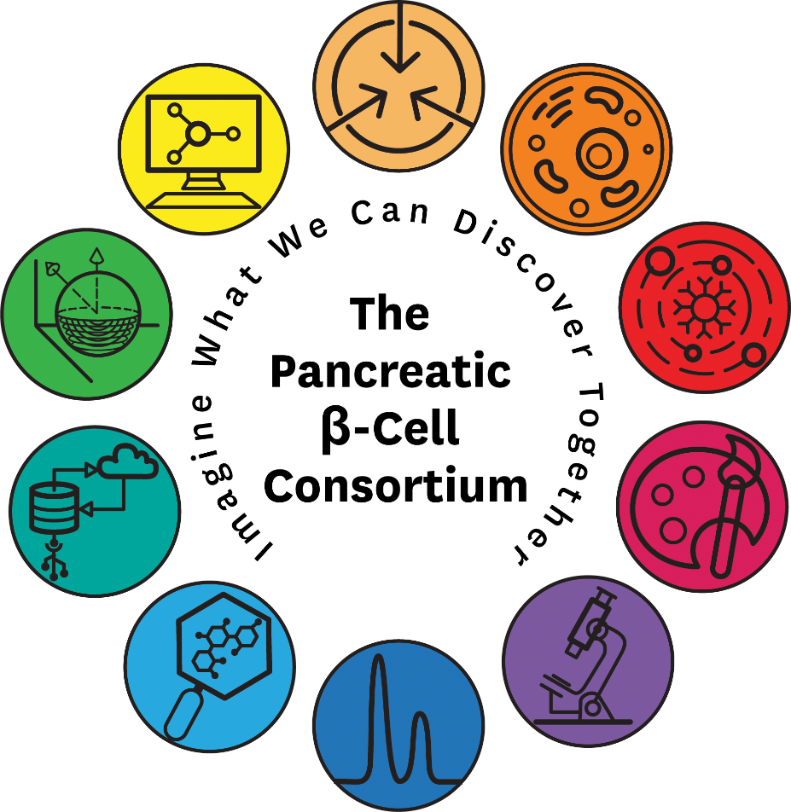


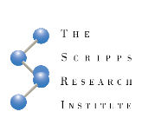








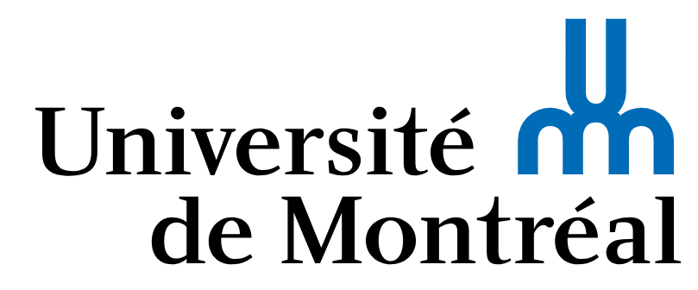

The Pancreatic β-Cell Consortium (PBCC)
Multi-disciplinary team
  Biologists
  Chemists
  Engineers
  Physicians
  Computational Scientists
  Digital Media Artists
Unbiased approach data-driven collaboration
Global, open science
Provide the basis for next generation drug and cell-therapy design
others welcome
www.pbcconsortium.org
Notes:
A significant strength is our multidisciplinary approach – centered around USC
Helen will tell us about a project with the cinema school on how we are explaining beta cell biology to general audiences. I will quickly mention that one of our undergrads that is working on phospho-proteomic analysis of beta cells also engaged with cinema students to develop an app for newly diagnosed children with diabetes. This is a collaboration between USC Engineering/Lifesciences/Cinema and CHLA. This student did this for fun, not for course credit or for class, but because she wanted. This is the atmosphere all the students are training in, highly multi-discplinary, creative and ambitious. Its extremely fun for me to watch the trainees (which I was a trainee when this started).
Stevens (McClary, Wang, Lin, Burdsall, Mittal, Zhang), White (Singla, Li), Fraser (Wang, Junge), Berman, Kesselman, Warshel (Alhadeff), Buchannan, McDowell, Graham (DQ), Finley (Gelbach), Fokin (Moreno), Sha (Francis)

